Slide 1
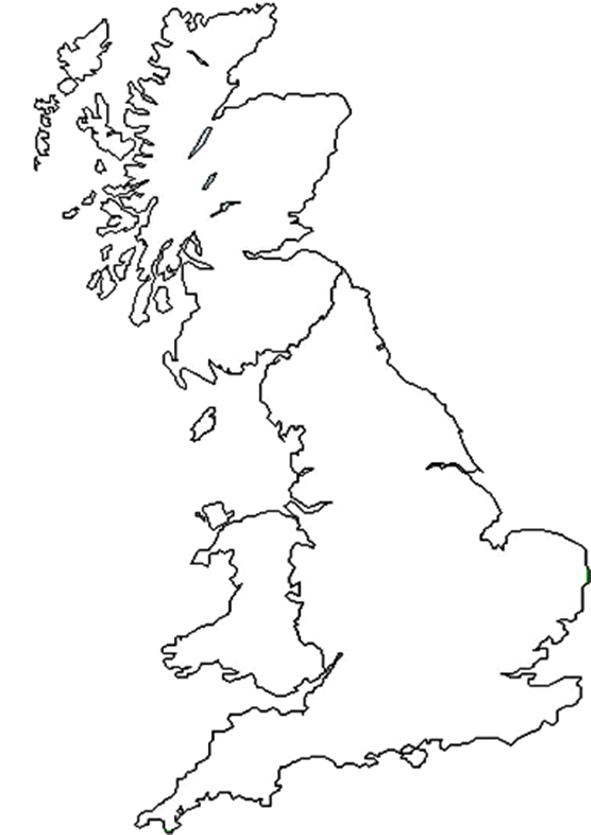
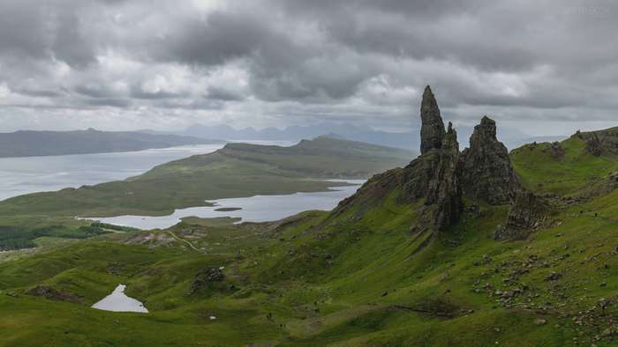
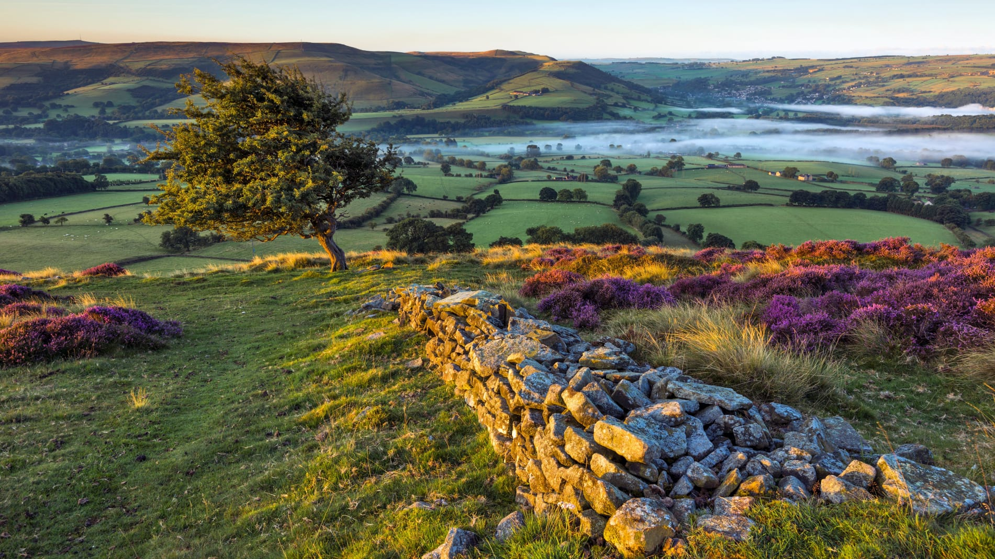
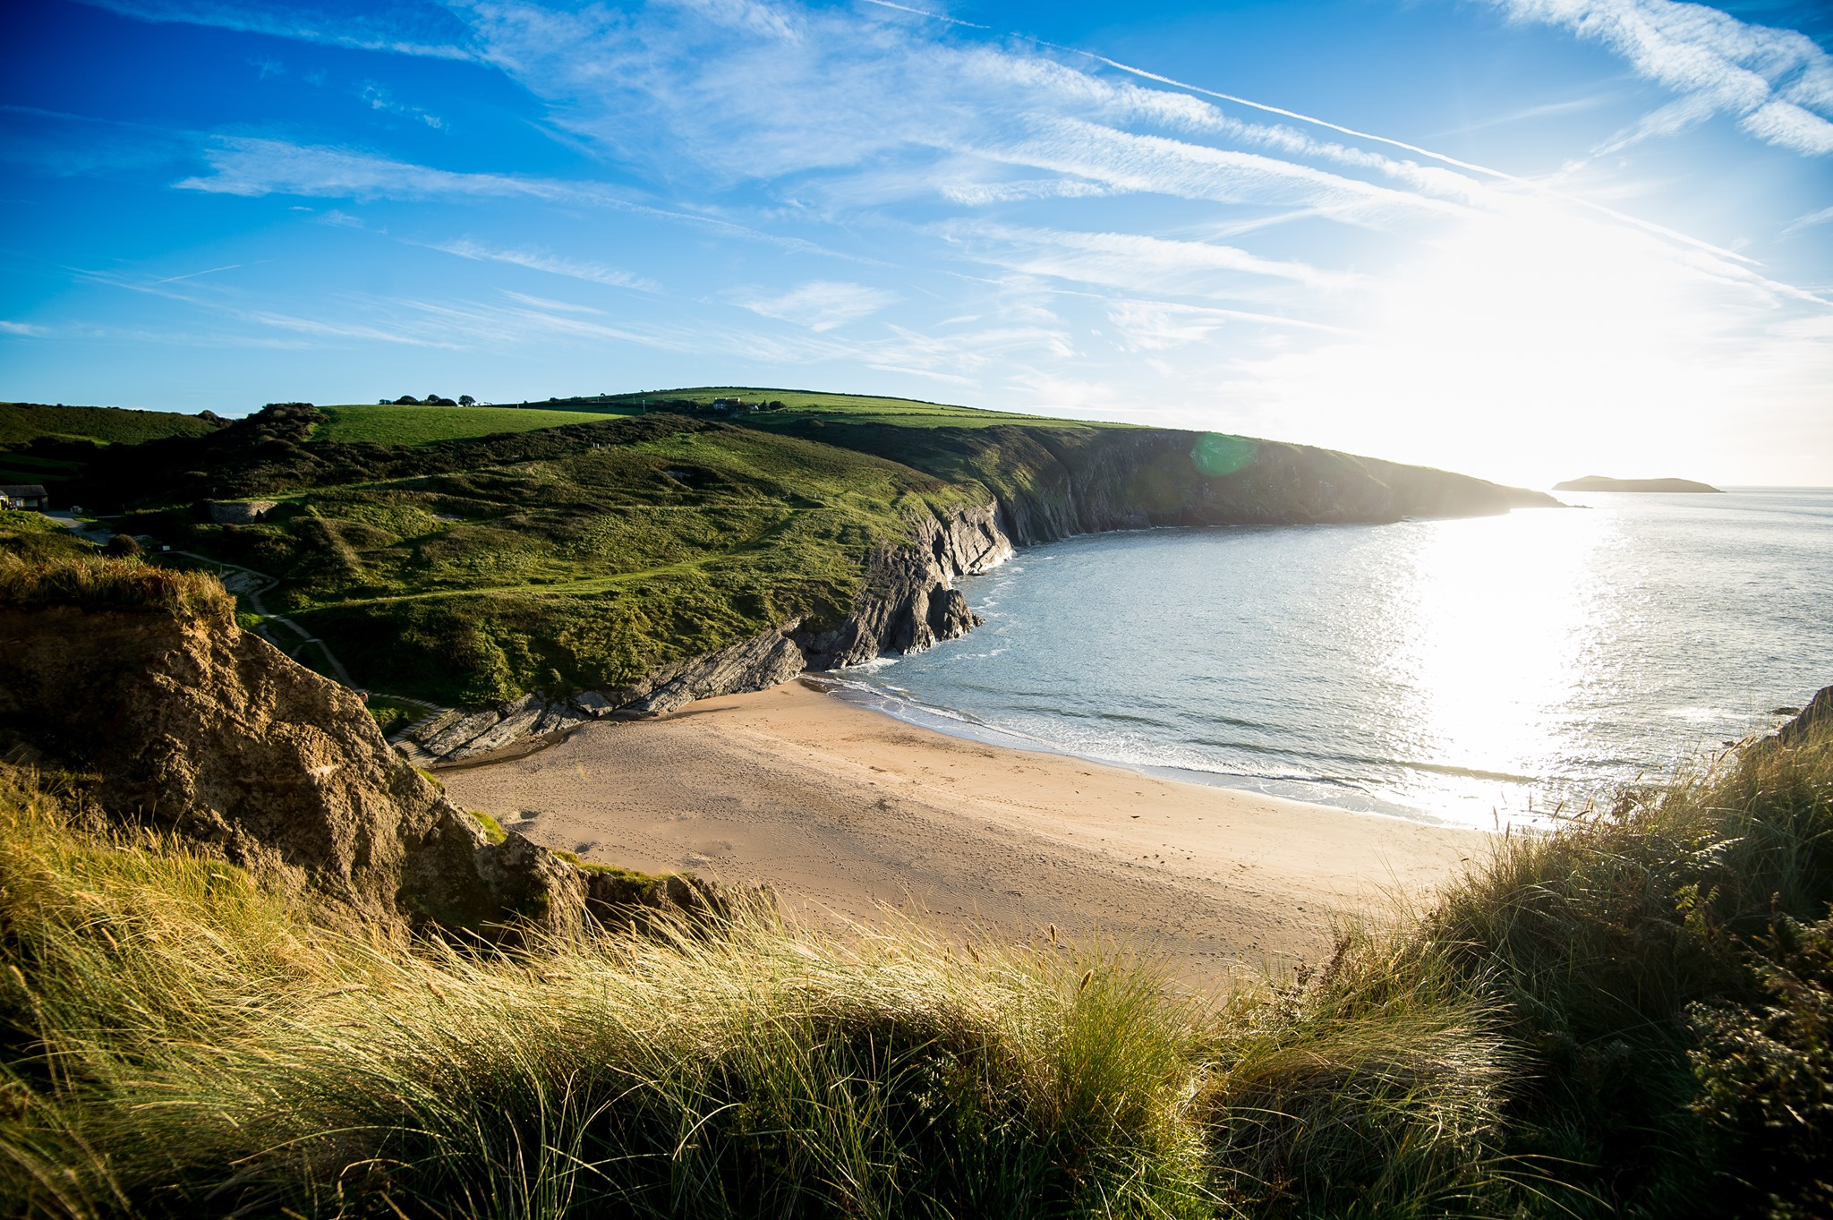

Slide 2
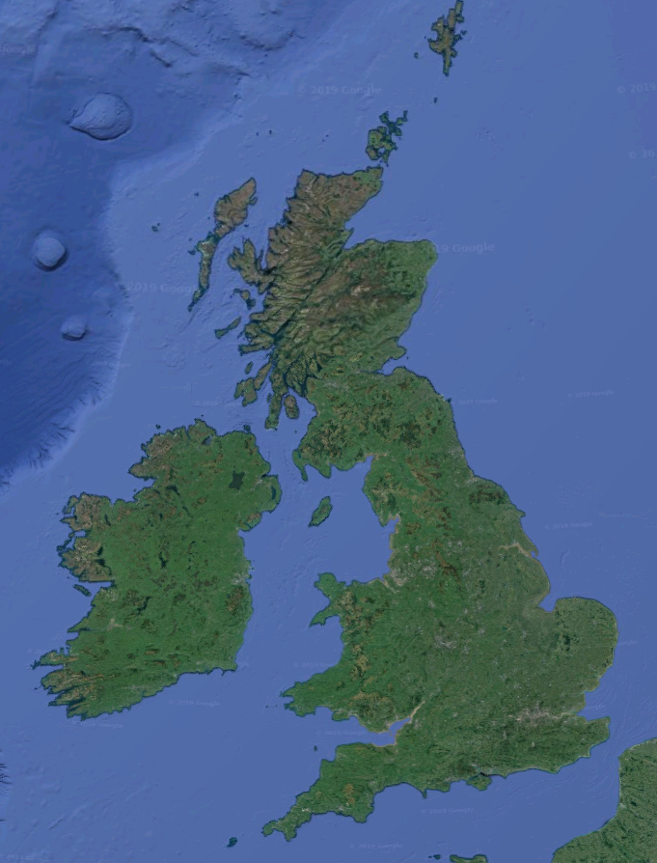
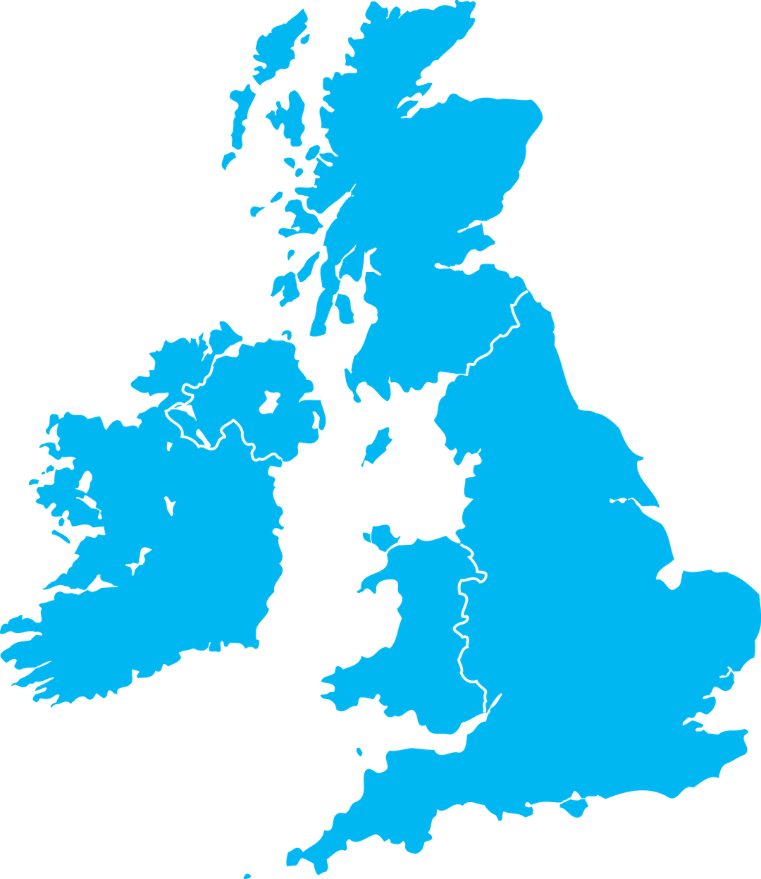

Slide 3
Geography of Great Britain
Kilian Heinrichmeyer, Q12

Slide 4
Structure:
Geography of Great Britain
Great Britain – Definition
States
Geographical position
England
Terrain
Interesting places
Scotland
Terrain
Interesting places
Wales
Terrain
Interesting places

Slide 5
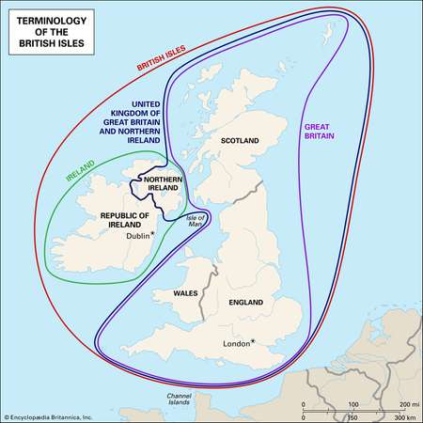
Great Britain – Definition
Geography of Great Britain
a. States
England, Wales and Scotland
Northern Ireland is in the UK not in Great Britain
Ireland and Great Britain together are the British Isles
(1) (2) (3) (4)

Slide 6
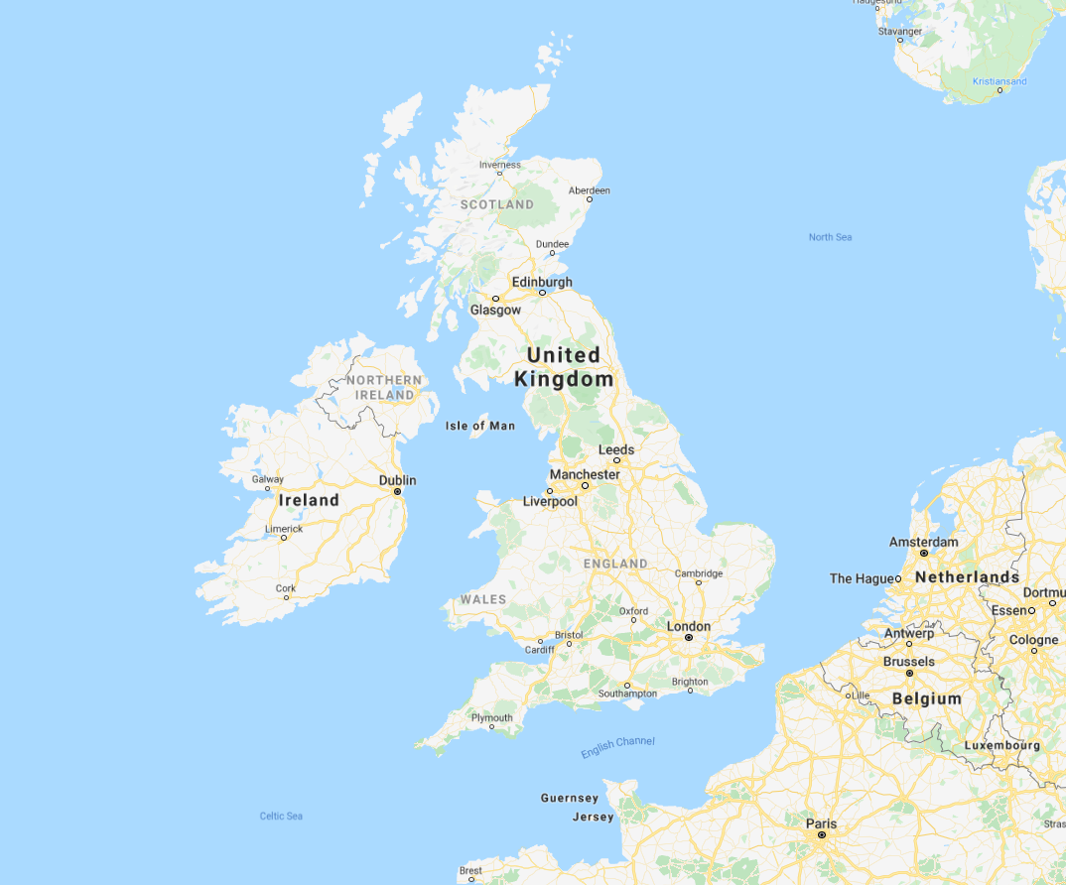
Geography of Great Britain
Great Britain – Definition
b. Geographical position
Northern hemisphere
Celtic Sea, North Sea, Atlantic
Westerlies
(1) (2) (3) (4)

Slide 7
Geography of Great Britain
Great Britain – Definition
b. Geographical position – climate
(1) (2) (3) (4)

Slide 8
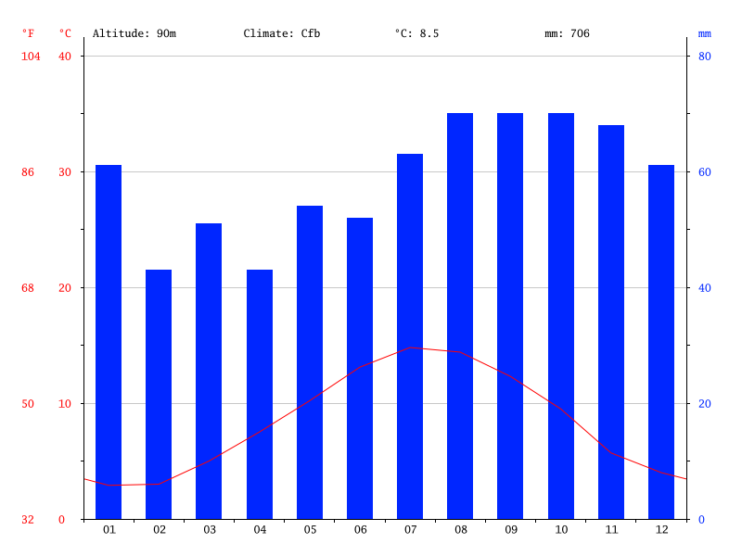
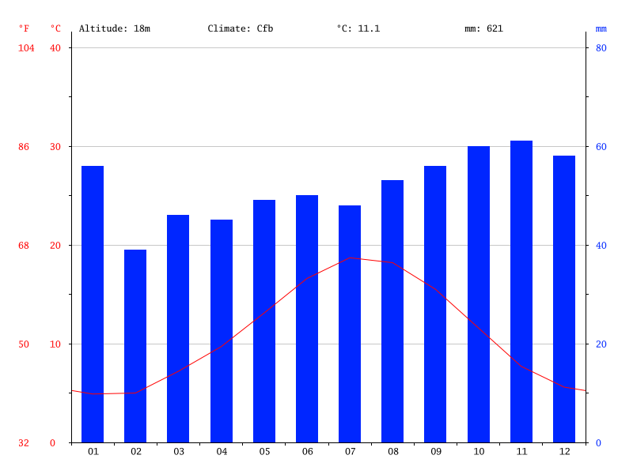
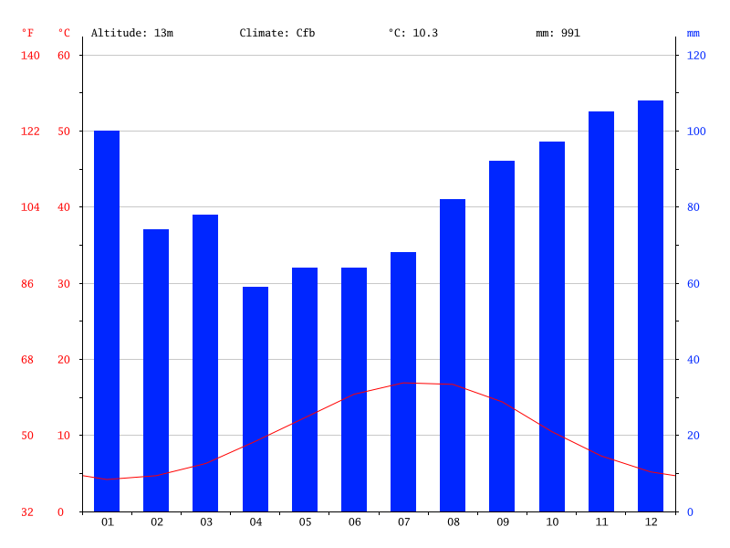
Wales - Cardiff
Scotland - Edinburgh
England - London
(1) (2) (3) (4)

Slide 9
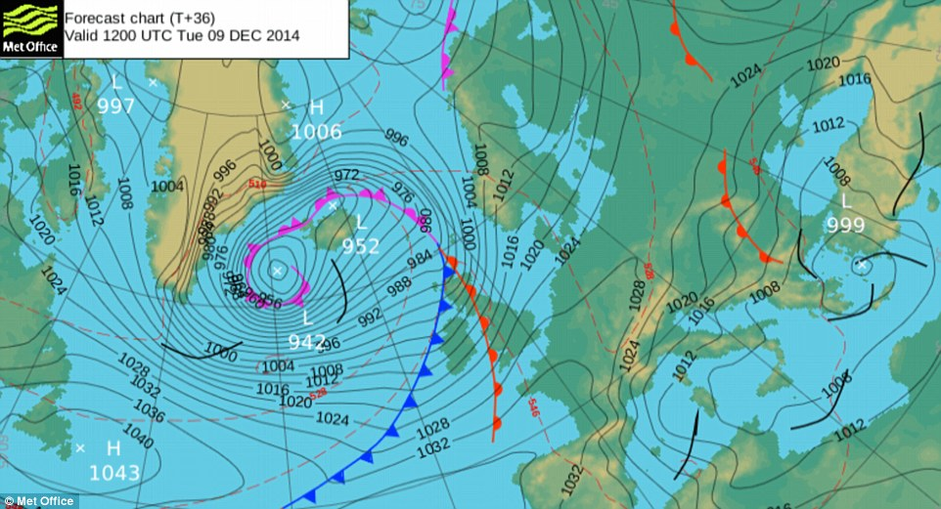
Geography of Great Britain
Great Britain – Definition
b. Geographical position – climate
Humid
Marine climate
Temperatur from 4°C up to 19°C
Precipitation from 600 to 1000 mm a year
(1) (2) (3) (4)
Notes:
Weather chart; pressure; loew pressure area; high-pressure area

Slide 10
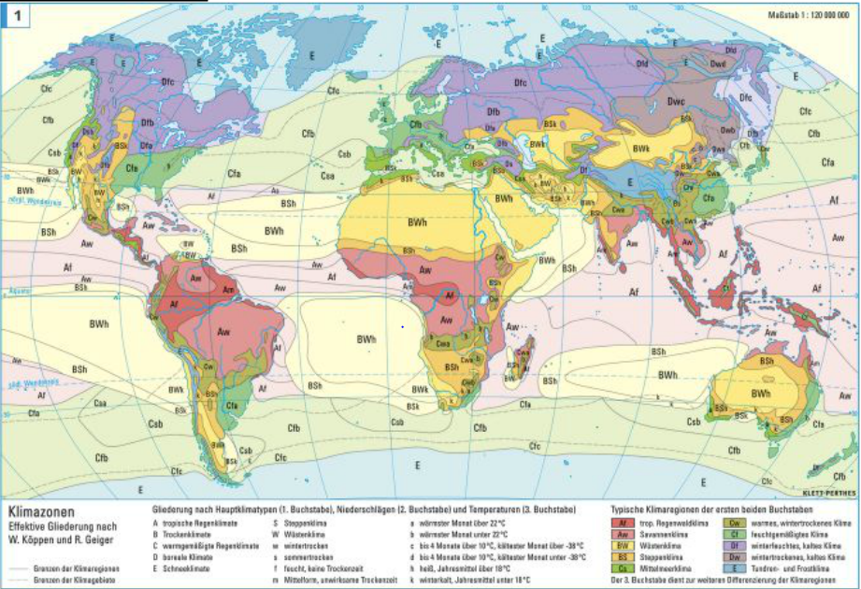
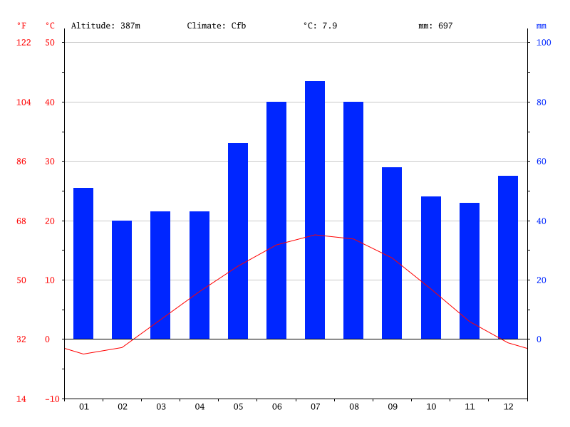

Slide 11
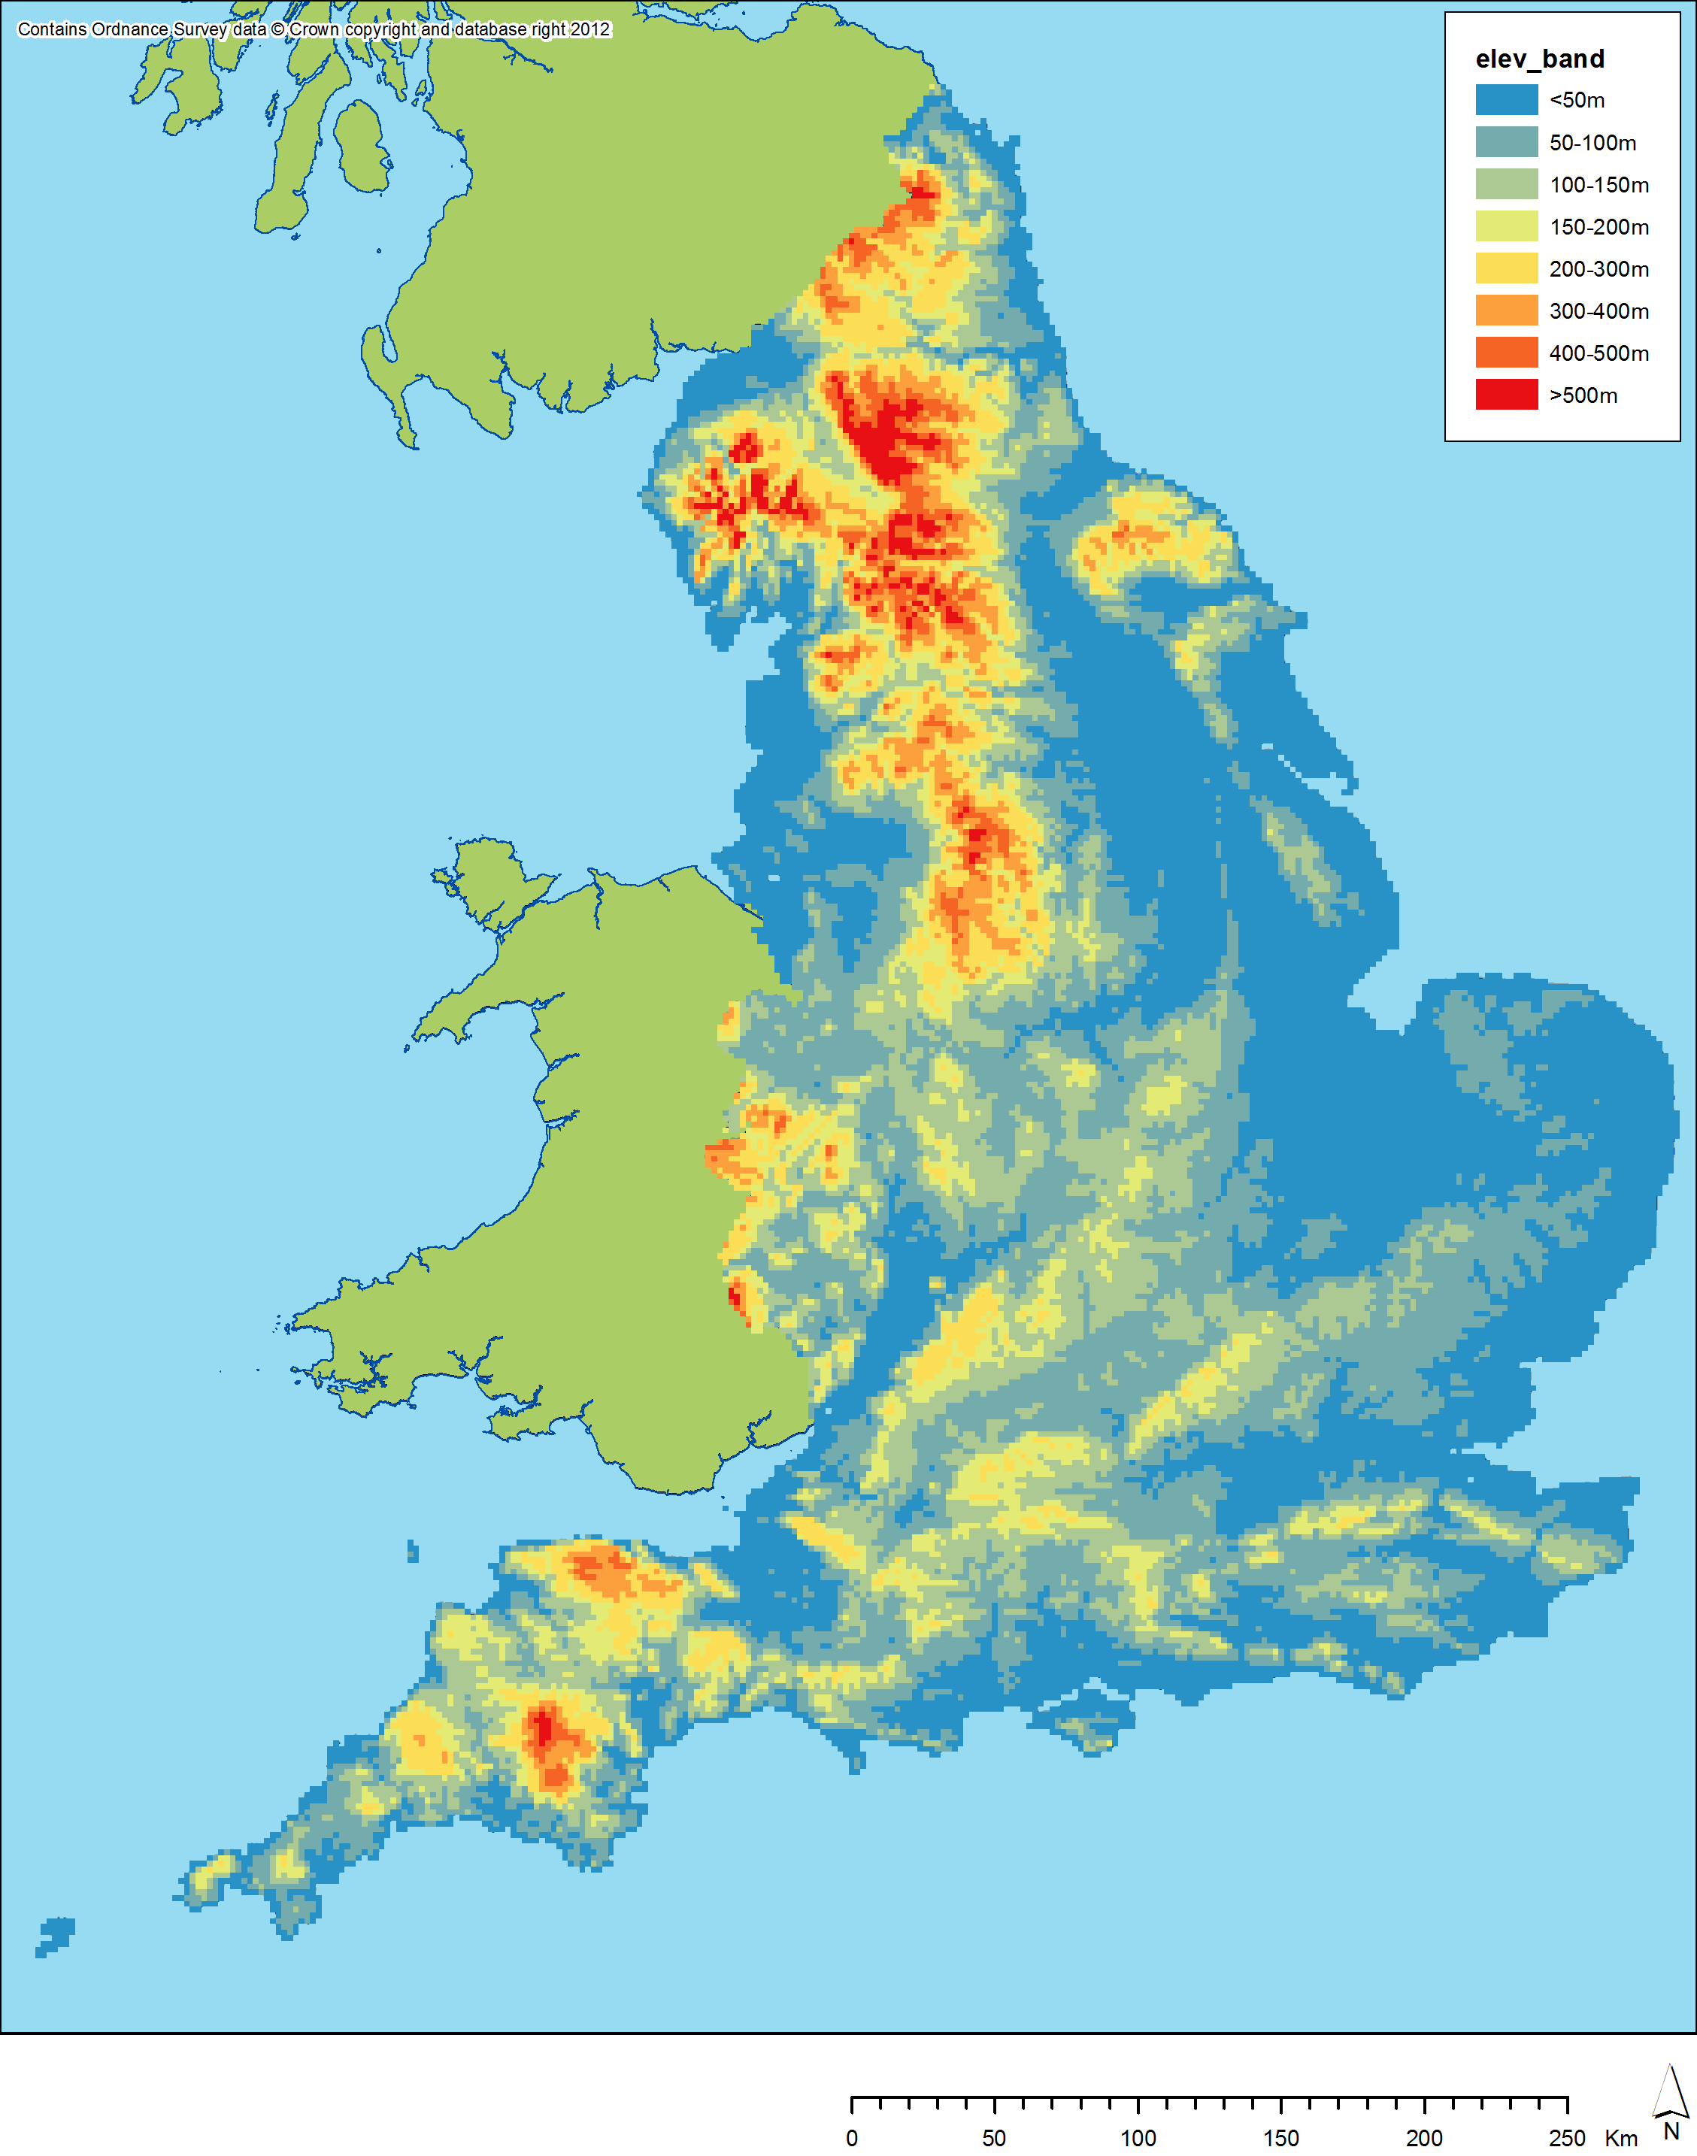
Geography of Great Britain
England
a. Terrain
Flat land
10 % woodlands
Grassland
More rugged in north
(1) (2) (3) (4)

Slide 12
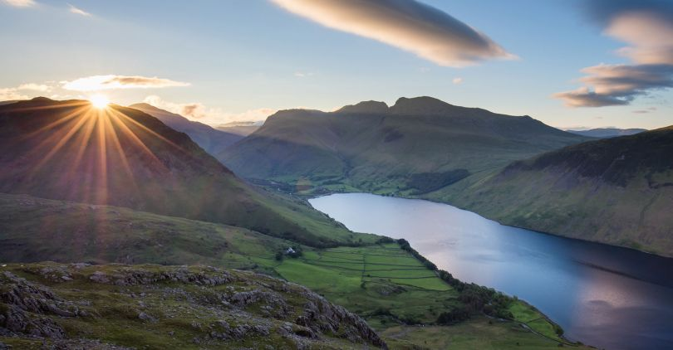
Geography of Great Britain
England
b. Interesting places
London
Lake District National Park
(1) (2) (3) (4)

Slide 13
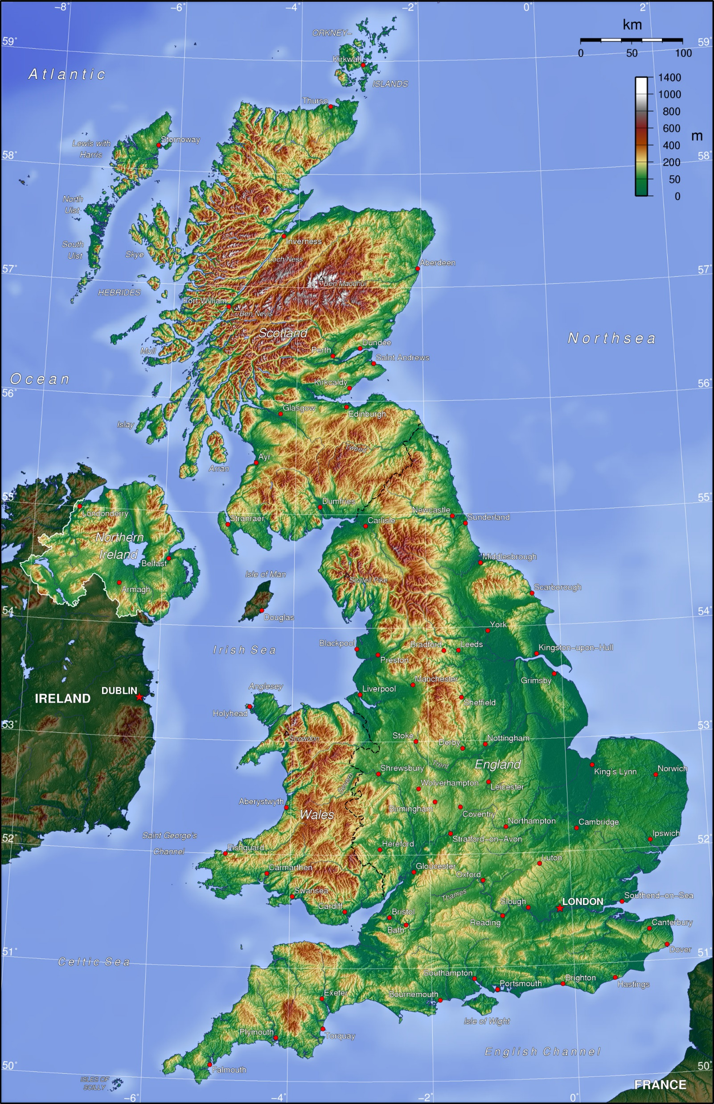
Geography of Great Britain
Scotland
a. Terrain
1,344m highest point in Great Britain
Rough landscape
Many rivers
Glacial formed
(1) (2) (3) (4)

Slide 14
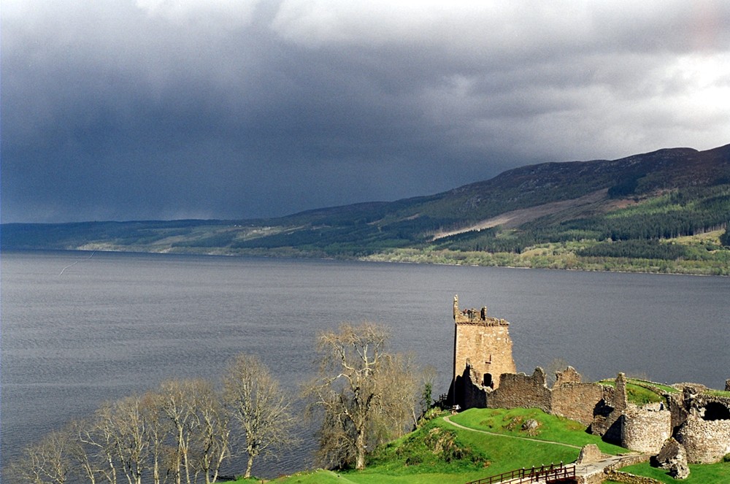
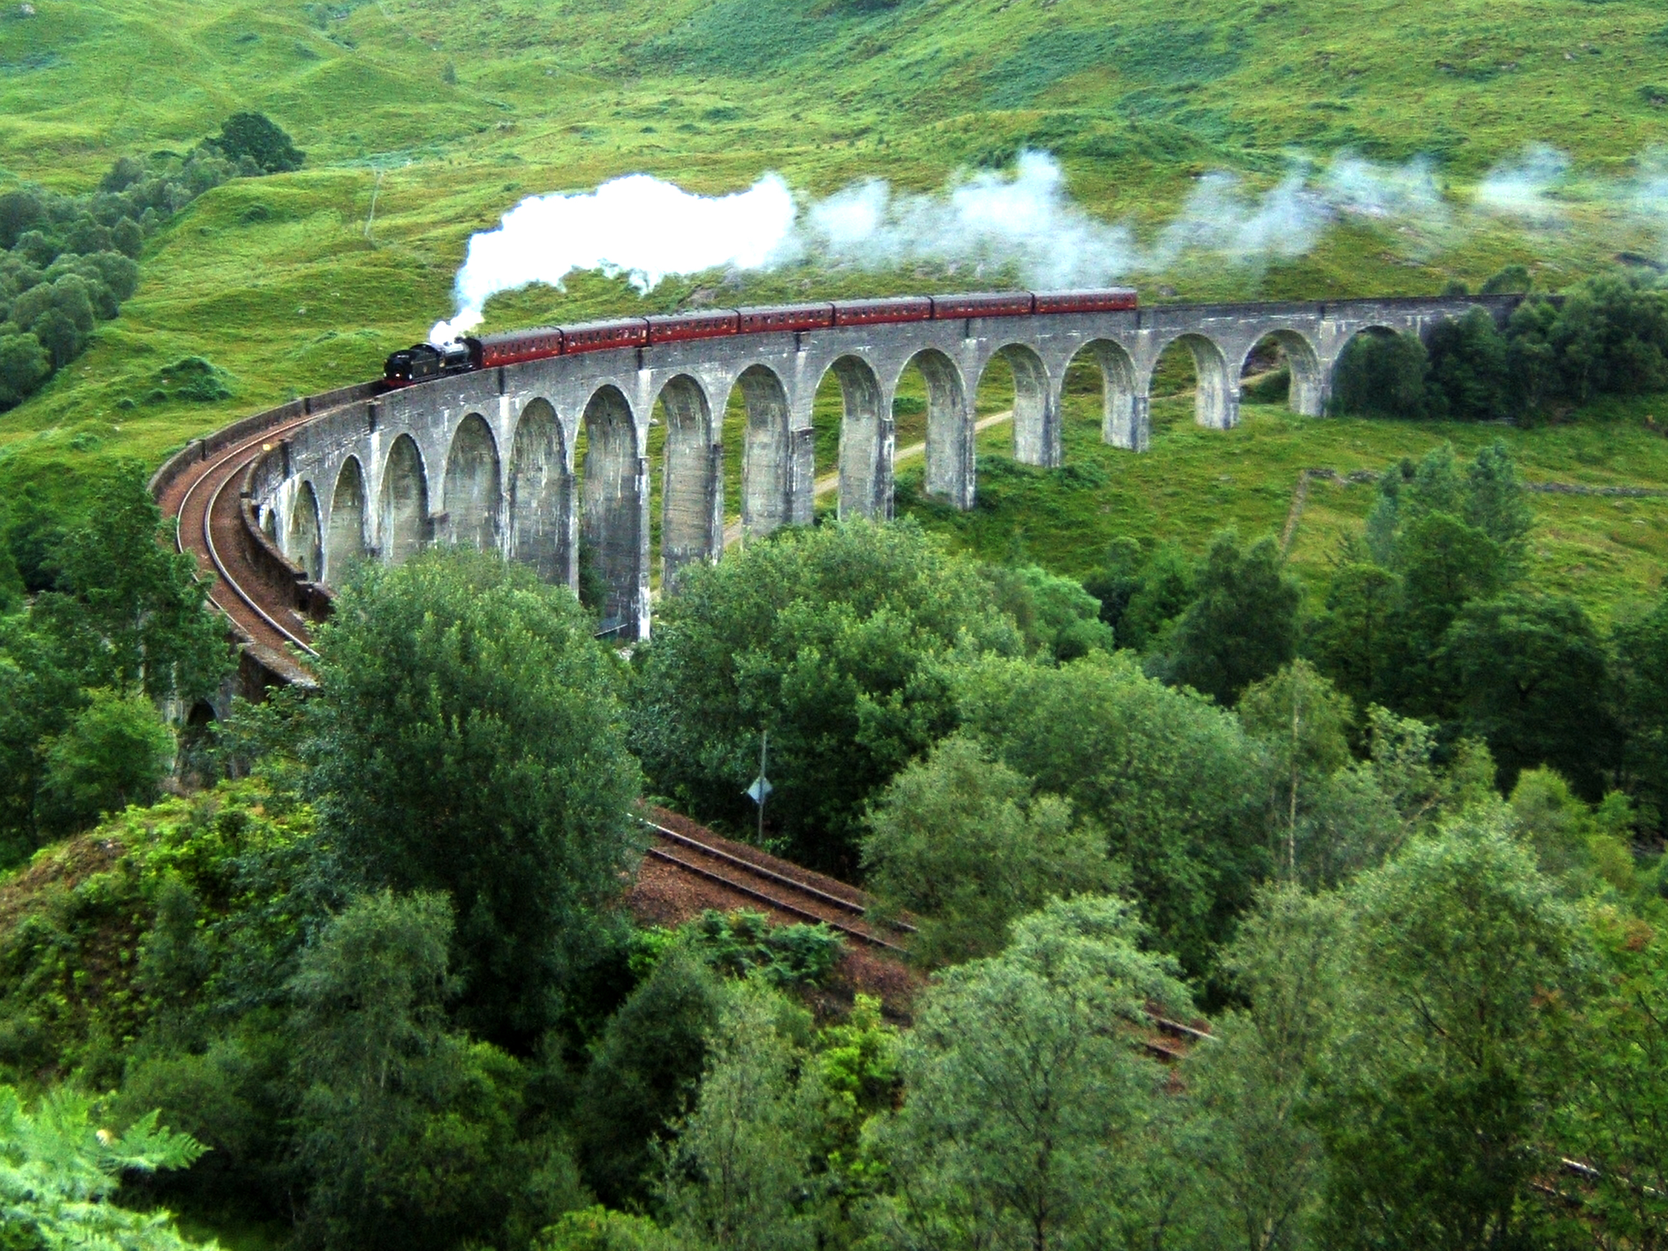
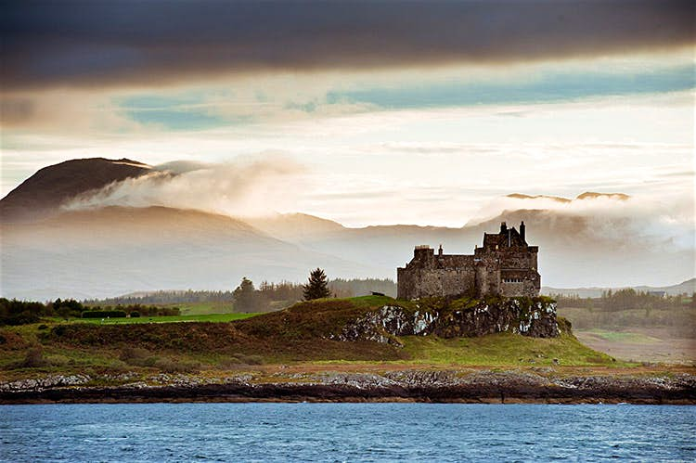
Geography of Great Britain
Scotland
b. Interesting places
Highlands
Loch Ness
Glenfian Viaduct
Hebrides
(1) (2) (3) (4)

Slide 15
Geography of Great Britain
Wales
a. Terrain
strong contrasts
80 % of used land agriculture
River valleys
Hilly
(1) (2) (3) (4)

Slide 16
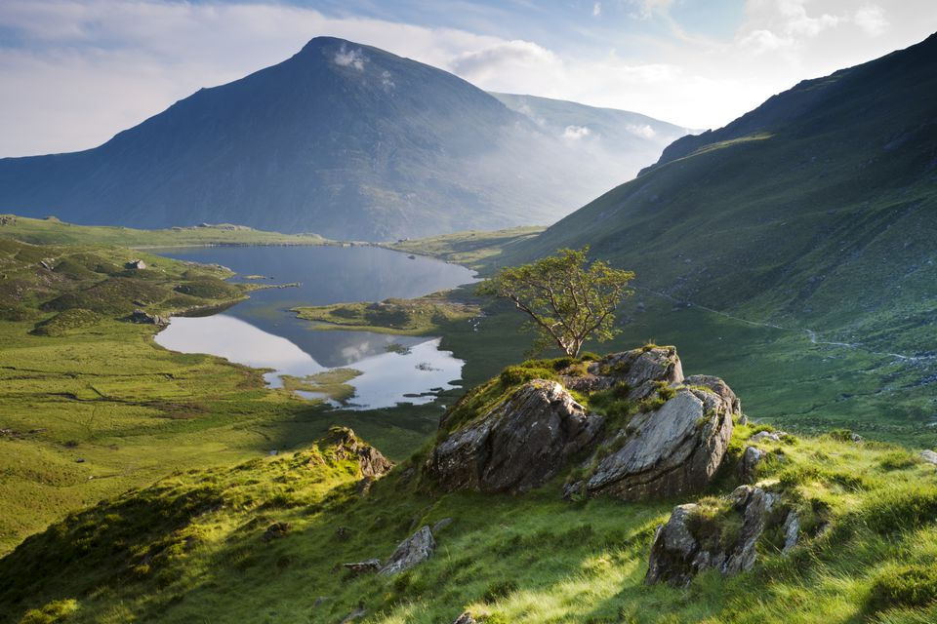
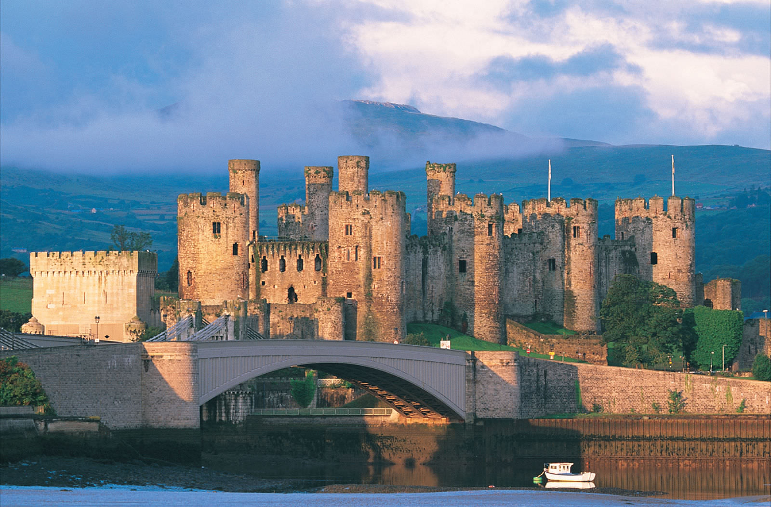
Geography of Great Britain
Wales
b. Interesting places
Snowdonia Nationalpark
Conwy Castle
(1) (2) (3) (4)

Slide 17
Thank you for the attention! Are there any questions?

Slide 18
Sources
https://www.facebook.com/50488206784/photos/p.10156742056711785/10156742056711785/
https://brexitcentral.com/some-special-brexit-arrangements-for-northern-ireland-are-likely-but-the-backstop-was-always-a-questionable-solution/
https://edition.cnn.com/travel/destinations/england
https://www.telegraph.co.uk/travel/destinations/europe/united-kingdom/england/london/articles/london-travel-guide/
https://www.britannica.com/place/Scotland
https://www.pngfly.com/png-ea9vml/download.html
https://www.britannica.com/place/Great-Britain-island-Europe
https://www.pngguru.com/free-transparent-background-png-clipart-krpjw
https://en.climate-data.org/europe/united-kingdom/england/london-1/
https://www.worldatlas.com/webimage/countrys/europe/scotland/uksland.htm
http://projectbritain.com/land.htm
https://www.worldatlas.com/webimage/countrys/europe/wales/ukwland.htm
https://www2.klett.de/sixcms/list.php?page=Infothek_artikel&extra=Haack%20Weltatlas-Online&artikel_id=261969&inhalt=klett71prod_1.c.139754.de
https://de.climate-data.org/europa/deutschland/bayern/cham-9476/#climate-graph
https://singletrackworld.com/forum/topic/online-maps-with-elevations-shown-in-heatmap-style/
https://www.google.com/url?sa=i&source=images&cd=&cad=rja&uact=8&ved=2ahUKEwjVrbLEnq7lAhUGaFAKHVvPClEQjRx6BAgBEAQ&url=https%3A%2F%2Feuropeupclose.com%2Farticle%2Fconwy-caernarfon-castles-north-wales%2F&psig=AOvVaw3vu3NI4Ctyoog2o12b9pLq&ust=1571777730390974
https://www.google.com/search?rlz=1C1AVFC_enDE828DE828&biw=2131&bih=1031&tbm=isch&sxsrf=ACYBGNSQ9HQnYlOEZD3BCzvubIVktzF96Q%3A1571691329707&sa=1&ei=QRuuXczbKonXwQLpqZOoCg&q=snowdonia-nationalpark&oq=snow&gs_l=img.1.0.35i39j0i67l5j0l4.926961.928254..929983...0.0..0.87.335.4......0....1..gws-wiz-img.rBJhD0dhKWM#imgrc=rsEP5qZI6sTsqM:

